Slide 1
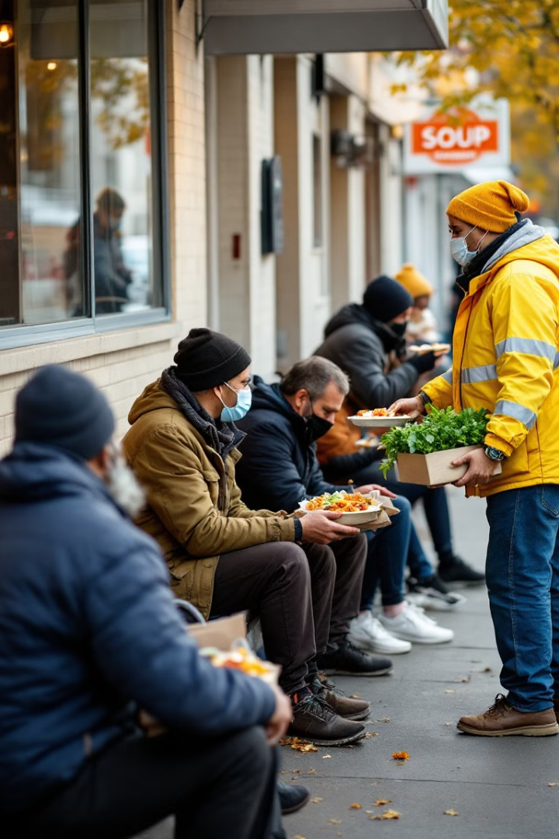

Leftovers to Livelihoods
by Aashish Thapa

Slide 2
The Problem
Food Waste
Homelessness
Inefficiency
In the US, around 84.3% of unused food in restaurants is thrown away while only 14% is recycled, and only 1.4% is donated.
Millions of people struggle with hunger and lack access to nutritious food.
A gap between surplus food and those in need.

Slide 3

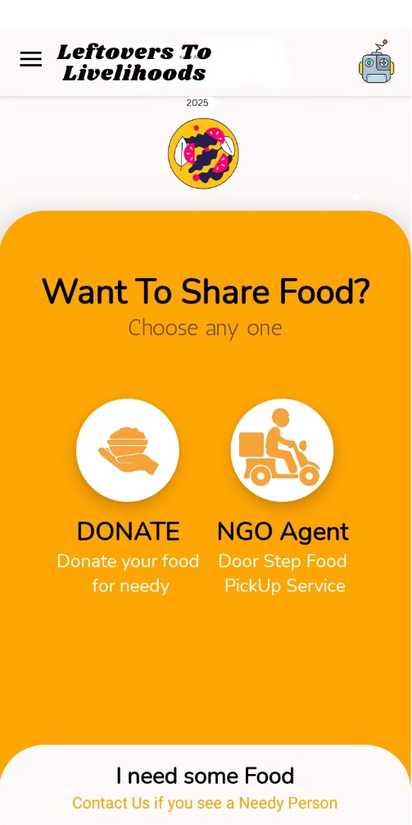
Our Solution
Connecting the Dots
Platform for food donors and recipients.
Real-Time Communication
Real-time notifications and updates streamline communication
Reduced Waste
Minimizes waste and maximizes resource utilization.

Slide 4
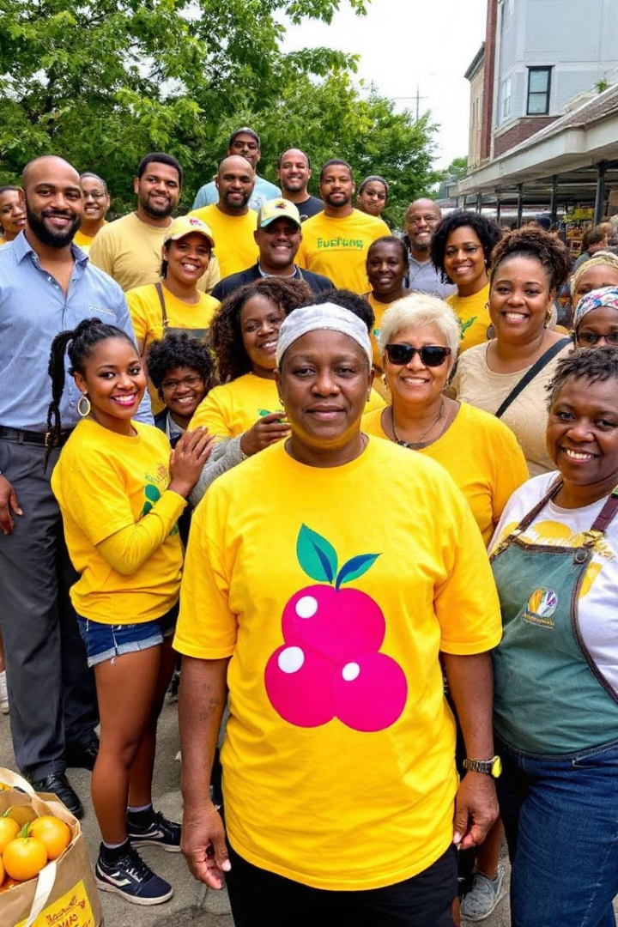




Target Audience
Restaurants
Significant food surplus,
Responsible waste management.
Grocery Stores
Food spoilage
Donate unsold items.
Food Banks
Require reliable access to food donations.
Homeless Shelters
Shelters rely on consistent food sources.

Slide 5
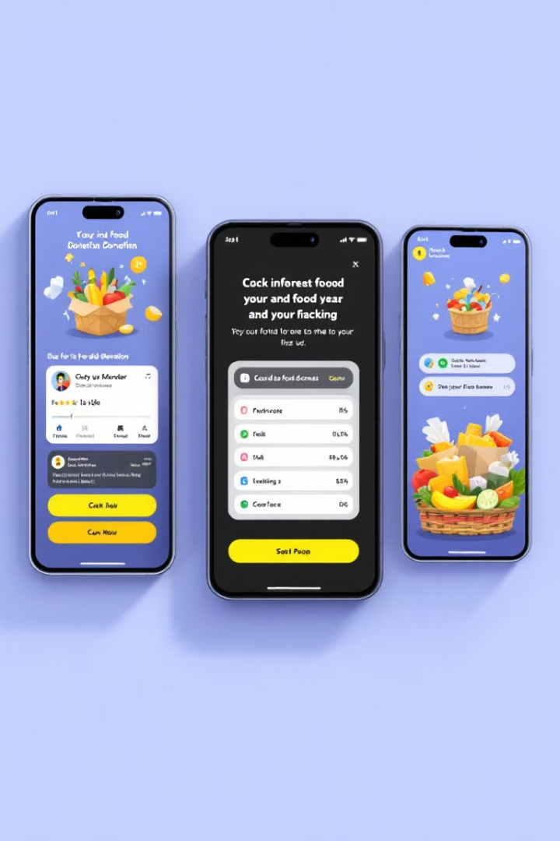
The Competition
1
Existing Apps
Lack real-time communication and user-friendly interfaces.
2
Our Edge
Real-time matching,
User-friendly navigation
3
Existing Non-Profit Organization
We do not compete, we support.

Slide 6
Funding Allocation and Validation
Develop a Minimum Viable Product (MVP)($50)
Hosting the platform in Amazon Web Services(AWS)($250)
Marketing and Outreach($200)

Slide 7
Thank You!

